Slide 1
Lecture 34

Slide 2
Question 123.10.1
In the work energy theorem, ΔK = ?
W
U
F
0.5mv²
²

Slide 3
Question 123.10.2
Mechanical work is defined as …
F/A
0.5mv²
PH 123

Slide 4
Question 123.10.2.4
The quantity ΔU = ?
-W
K
F
45.3mv²
²

Slide 5
Question 123.10.2.5
A force, F, does work. Which of the F vs x diagrams represents the most work done?
F
B
A
A
x
F
B
B
A
x

Slide 6
Question 123.10.3
Is mechanical energy conserved?
Yes
No
Maybe sometimes

Slide 7
Question 123.10.4
How much heat is contained in this room?
100000J
100000K
100000BTU
This is a dumb question, rooms don’t “contain” heat.

Slide 8
Question 123.10.5
Which PV graph represents a cyclic process?
A
B
C

Slide 9
Question 123.10.6
By observing a system we find that
W = -Q
What can we say about the system?
It is isolated
It is cyclic
It is isobaric
It is closed

Slide 10
P_{i} V_{i}
F_{ex}
F_{gp}
Δx
P_{f} V_{f}
F_{ex}
F_{gp}

Slide 11
ACME Pianos
UP
N_{BF}
N_{BL}
N_{B6}
f_{BFk}
W_{BE}

Slide 12
P
P_{i}
P_{f}
V
V_{i}
V_{f}

Slide 13
P
P_{i}
P_{f}
V
V_{i}
V_{f}

Slide 14
P
P_{i}
P_{f}
V
V_{i}
V_{f}

Slide 15
P
P
P
P_{i}
P_{i}
P_{i}
P_{f}
P_{f}
P_{f}
V_{i}
V_{f}
V
V_{i}
V_{f}
V
V
V_{i}
V_{f}

Slide 16
Question 123.10.6
Which graph represent the most work done on the system?
P
P
P
P_{i}
P_{i}
P_{i}
P_{f}
P_{f}
P_{f}
V_{i}
V_{f}
V
V_{i}
V_{f}
V
V_{i}
V
V_{f}
A B C

Slide 17
T = 290K

Slide 18
T = 590K

Slide 19
T = 590K
T = 290K

Slide 20



$$E_{2_{int}}$$
$$∆E_{int}$$
$$E_{1_{int}}$$

Slide 21
$$E_{2_{int}}$$
$$∆E_{int}$$
$$E_{1_{int}}$$

Slide 22
$$E_{2_{int}}$$
$$∆E_{int}$$
$$E_{1_{int}}$$

Slide 23
$$E_{2_{int}}$$
$$∆E_{int}$$
$$E_{1_{int}}$$

Slide 24
$$E_{2_{int}}$$
$$∆E_{int}$$
$$E_{1_{int}}$$

Slide 25



$$T_{2}$$
$$∆T$$
$$T_{1}$$

Slide 26
End

Slide 27
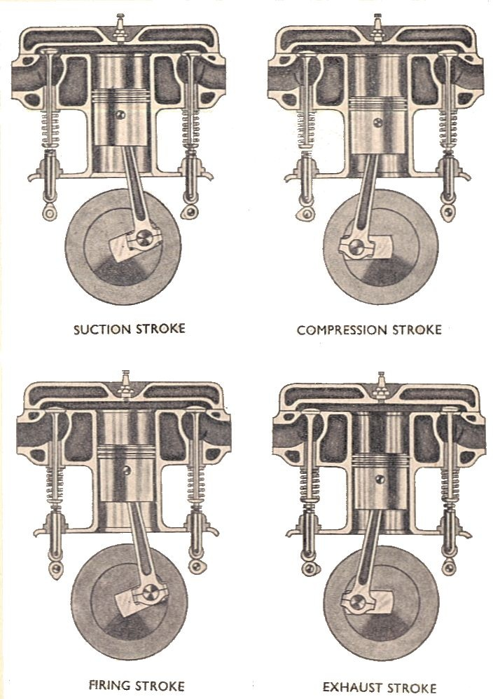
Manual of Driving and Maintenance for Mechanical Vehicles (Wheeled)

Slide 28
C
B
Pressure (Pa)
D
I
A
Volume (m³)

Slide 29
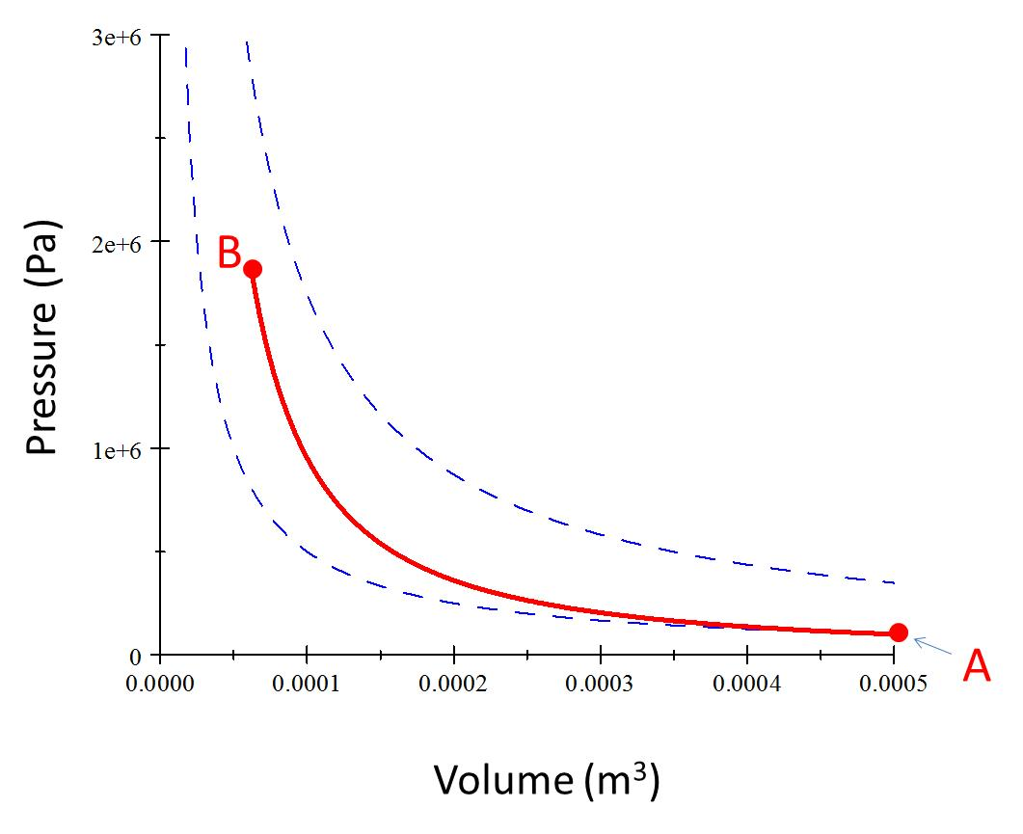
Process AB
Piston raises

Slide 30
C
B
Pressure (Pa)
Volume (m³)

Slide 31
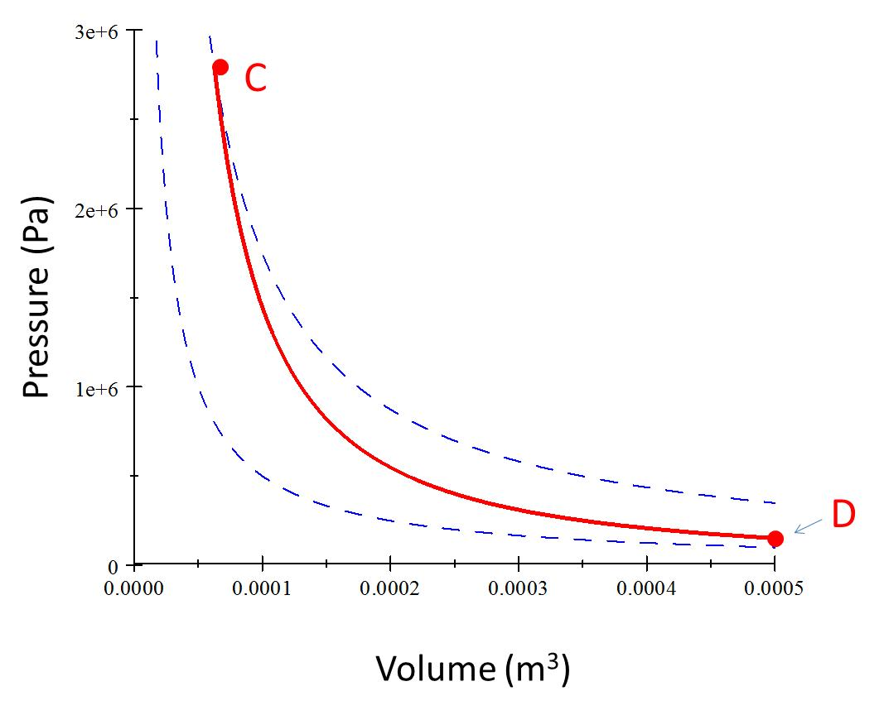
Process CD (Power Stroke)
Piston Lowers

Slide 32
Pressure (Pa)
D
A
Volume (m³)

Slide 33
Process AI
Exhaust valve opens
Piston rises

Slide 34
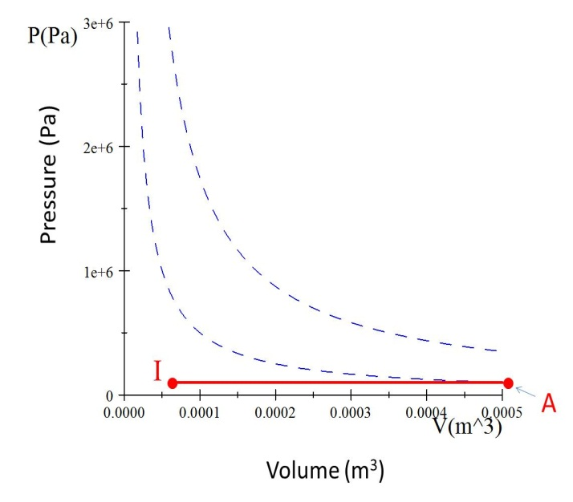
Process IA
Intake valve opens
Piston Lowers

Slide 35
C
Q_{h}
B
Pressure (Pa)
Work Required
Useful Work Out
D
I
Q_{c}
A
Volume (m³)

Slide 36
B
Pressure (Pa)
A
Volume (m³)

Slide 37
C
Pressure (Pa)
D
Volume (m³)

Slide 38
Pressure (Pa)
I
A
Volume (m³)

